Slide 1
The Voice of the Customer: Using NLP & Social Media to Extract Customer Feedback
DATAcated Conference - May 19, 2021
Kendall Ruber | Sr. Data Analyst, Yum! Brands
Notes:
Hi everyone! Thanks Kate for the introduction. Today, I am going to show how companies can go about extracting and analyzing valuable customer feedback from social media platforms using Natural Language Processing packages straight out of the box from Python. Let’s jump in!

Slide 2
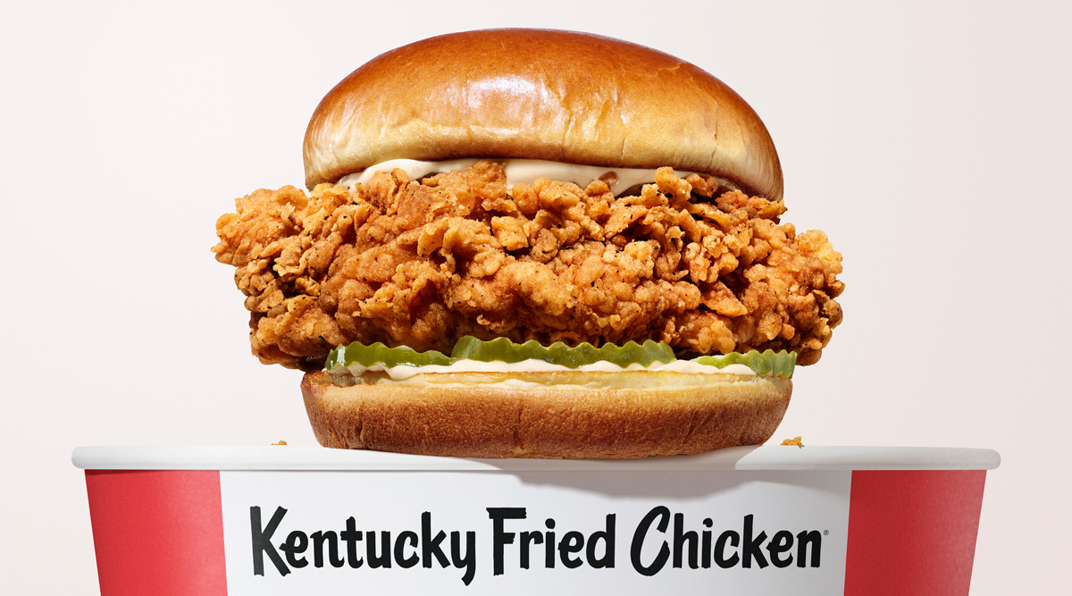

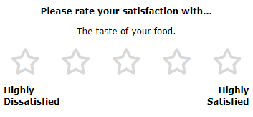
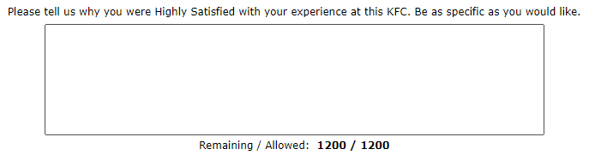


Traditional Channels of Customer Feedback
Notes:
Before I get to talking about social media, I want to discuss how companies traditionally have solicited feedback from their customers.
At Yum! – we are home to some of the world’s most famous brands, including KFC. I’m sure many of you have heard about our new chicken sandwich – and if you haven’t go try it!
Like many other organizations, one of the ways we track customer satisfaction with this new product is thorough our customer satisfaction survey at the bottom of the receipt.
Companies have long utilized customer satisfaction surveys and questionnaires to solicit feedback from consumers on their products. These typically consist of a series of prompts, followed by either multiple choice or short answer responses.
The screenshots to the right show actual questions we ask on this survey, paired with real results. As you can see, these are pretty straight forward.

Slide 3

Why turn to social media?
Prompted and pre-selected responses.
Raw, honest, and unsolicited feedback. This is where we gain the truest insight.
Going viral = large-scale advertising.
Social media reaches both current and potential customers.
Global reach.
When Customers Speak, We Listen
Survey Limitations
Incorporating feedback is key to long term success.
Customers creating content with our products demonstrates engagement.
Scale
Notes:
So, why should companies turn to social media in addition to these methods?
Survey Limitations: Survey responses are directly prompted, and answers are often pre-selected. This limits both the type and depth of feedback we can receive. On social media on the other hand. customer feedback is raw, honest, and often unsolicited. This is where we are going to see what our customers are talking about, *without* us asking them.
Scale: Going viral is the new form of large-scale advertising. Just make sure you are going viral for the right reasons! Social media reaches both current and potential customers – think Tik Tok challenges and mock recipe videos on YouTube.
When Customers Speak, We Listen: Customers creating content with our products and brands shows we are engaging our audience, which is key to long term brand and product success.

Slide 4

Where do I begin?
Notes:
You may be wondering – so where do I begin? Like any role in analytics, most of the heavy lifting is done in cleansing and pre-processing your data.

Slide 5
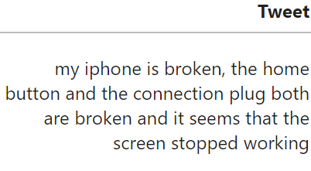
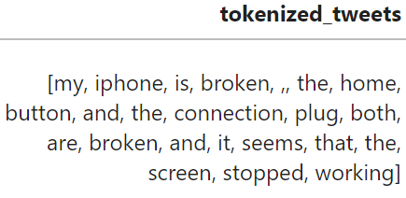
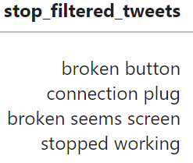
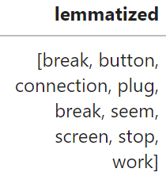
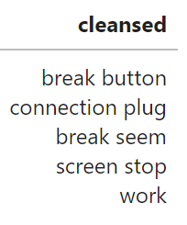
Text Cleansing Journey
Import raw data from Sentiment140 dataset. Keep tweets containing “iPhone.”
Remove stopwords.
Your cleansed text is now ready for further analysis!
Format text and tokenize tweets.
Avoid redundancy by lemmatizing the tweets.
Notes:
For this project, I downloaded the Sentiment140 dataset that is publicly available on Kaggle. This dataset contains roughly 1.6 million tweets – so first, I have filtered to only tweets containing the word “iPhone”. This is to center our tweets around a specific product, like a company would want to do if it were looking to measure the success of a new product release.
This visual shows the various text cleansing stages for one of the tweets in our dataset, starting from the raw input and resulting in a new “cleansed” column.
First we convert the text to lowercase, remove all Twitter handles. And tokenize the text into individual words before further processing.
Then, we focus on removing common words like “it” and “the” from the analysis that have a high frequency but do not add to the context of the tweet. Here the stop words are chosen from NLTK’s out of the box sotp words dictionary, with other company and industry specific words like “phone” removed as well.
Next, we lemmatize the tweets, which converts words like “run,” “running,” and “ran” to their root word, run. This reduces a lot of the redundancy that may be present in the dataset, because all of these words essentially convey the same idea – someone is running. You can see how this works in the example where the customer states “my iphone is broken” at the beginning of the tweet. “Broken” is converted to its infinitive form “break”.
And finally, we are left with our cleansed dataset. This is by no means a comprehensive list of techniques to clean your text data, but it gives us a great start! You can see here that the cleansed tweet is about 1/3 of the length of the original tweet, and the filler words and extra noise has been removed, leaving only the most relevant information to what the customer is tweeting about.

Slide 6

Gathering insight.
Notes:
In our next slides, I’ll show how we can take our cleansed text and gather insight!

Slide 7
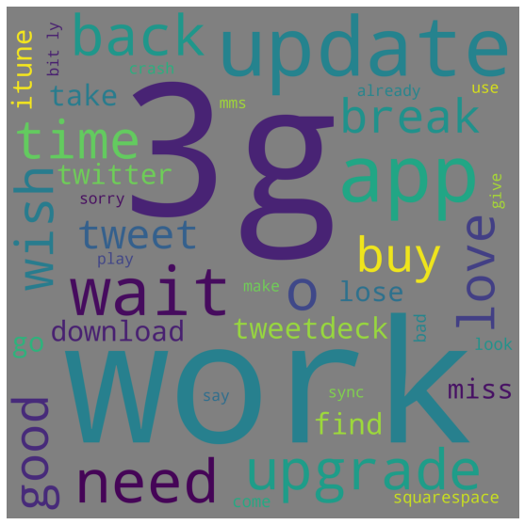
Visualizing Results
A word cloud is a popular way of visualizing text data. The larger the word, the more times it is mentioned in the text.
What are your customers talking about?
Are there any words standing out to you?
Notes:
First I’ll start with a very popular way to visualize text data that most of you are probably familiar with – a word cloud. For those not familiar with a word cloud, the larger a word is, the more frequently it is used in your text. This is a great way to see at a high level what your customers are talking about. Take a quick look and notice which words stand out to you.

Slide 8

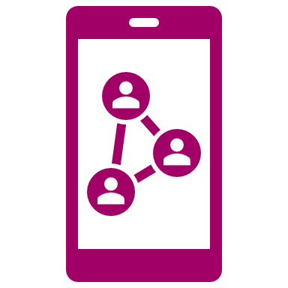

3G
Tweetie/TweetDeck/Twitter
Bitly
The second generation of iPhone, successor to the original iPhone.
Release Date: June 9, 2008
Tweetie, the original Twitter app for iOS, was initially released on November 19, 2008.
TweetDeck, a social media dashboard application for management of Twitter accounts, was released July 4, 2008.
URL shortening service and a link management platform commonly used in social networking, SMS, and email.
Release Date: February 12, 2008
Sentiment140 was extracted in 2009… Context is everything in text analytics!
*https://www.apple.com/newsroom/2008/06/09Apple-Introduces-the-New-iPhone-3G/
*https://en.wikipedia.org/wiki/TweetDeck
*https://en.wikipedia.org/wiki/Bitly
*https://en.wikipedia.org/wiki/Loren_Brichter
Notes:
There are 3 words here that stand out to me: 3G, a few different Twitter words, and Bitly. All of these words are relevant to the iPhone, but why am I focusing on a bunch of technologies released in 2008? Well, if you are familiar with the Sentiment140 dataset, you may know that all of these tweets were extracted in 2009!
This is probably one of my favorite slides of this entire presentation – which demonstrates how crucial timing and context is to text analytics! These results would likely not be the same if we were to pull these tweets today. (I was literally googling some of these terms because full disclosure, 2008 was many years before I owned an iPhone.
Results like this show Apple that customers were in fact talking about their new product releases, demonstrating the customer’s engagement with the brand and the impact these new releases had on their customers.

Slide 9
Sentiment Analysis
We want to know how our customers are feeling, whether it is…
the GOOD
the BAD
the NEUTRAL
Notes:
Sentiment analysis is another method to gain quick insight on your data. Keep in mind these sample tweets don’t make a lot of grammatical sense since they come from our cleansed data, but you can still get an overall feel for how customers are feeling about your product.

Slide 10
Uncovering patterns.
Notes:
To dive deeper, we may want to investigate and see if there are recurring themes in what our customers are talking about. Are there hardware issues with our product? Does the battery tend to die frequently? What are our customers using our product to do in their daily lives?

Slide 11
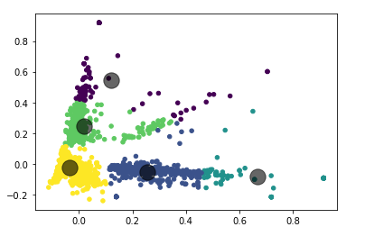
Text Clustering
Can we identify patterns among what our customers are talking about?
Unsupervised machine learning algorithms are able to cluster Tweets into groups based on their subject matter.
Notes:
One way to study this is to perform text clustering. In this example, these Tweets are not previously labeled, so we can use unsupervised machine learning algorithms like KMeans to cluster our Tweets into groups based on their subject matter.
This is done by converting each word in a tweet into a number so it can be processed by the machine. These numbers are then transformed to an array so they can further be analyzed by the computer. Next, an estimated number of clusters is chosen, and the center of each cluster is calculated. From there, a data point is then assigned to a cluster, which is determined by whichever center of the cluster it is closest to, indicated by the large grey dots. These clusters and their centers are continually updated as more data is added to the model.
As you can see in the image to the right, our dataset yielded 5 distinct clusters.

Slide 12
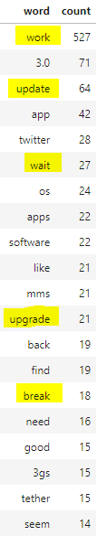
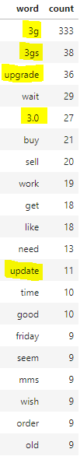
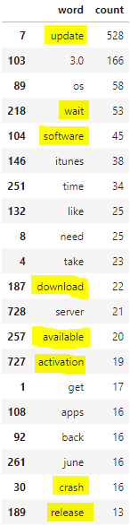
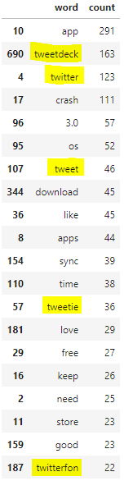
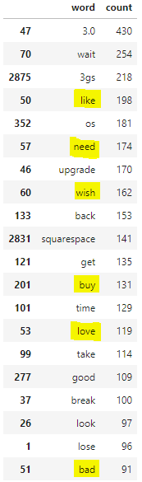
Upgrades
3G
Software and App Updates
Twitter
Product Inquiries and Feedback
Notes:
This slide shows the top 20 words from each of the resulting clusters. As you read through the words, you may notice that the words tend to lean toward an overall theme. Each cluster is labelled according to its theme, resulting in clusters for 'Upgrades','3G', 'Software and Application Updates', 'Twitter', 'Product Inquiries and Feedback’. Clustering customer feedback in this manner allows businesses to see what their customers are buzzing about – remembering slides from earlier, it is no surprise we ended up with a 3G and Twitter cluster.

Slide 13
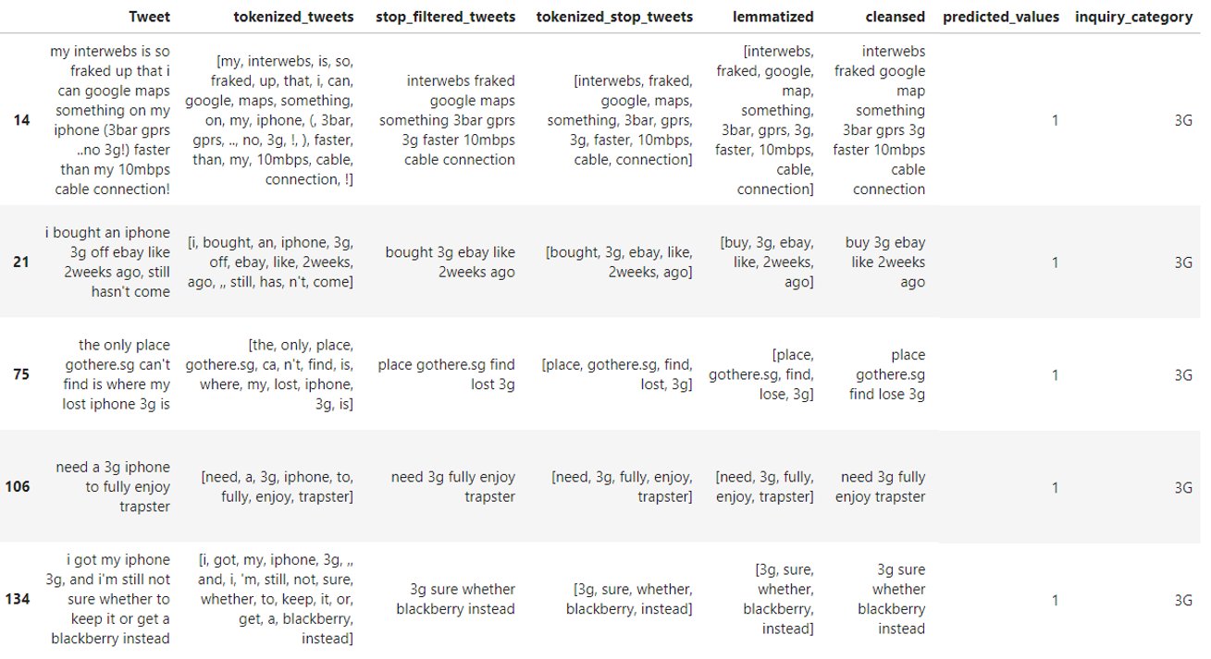
Spot Check
Notes:
It is always a great idea to preview your predicted cluster results to ensure that your model’s classifications seem logical.
For the sake of time, here I am showing a preview of the tweets classified under the “3G” cluster. When reading the original Tweets, it is clear to see why the model clustered these tweets together!

Slide 14





How can I apply these tools in my work?
Targeted Advertisements
Create a hashtag to engage customers
Flag Problematic Reviews or Comments
Identify Areas of Improvement
Guide Relevant Public Communications
Study a competitor’s behavior
Notes:
To close out this presentation, I wanted to provide some ideas as to how you can apply this in your own organization. Tying back to how we might apply this type of work to the KFC chicken sandwich – can we identify areas of improvement with the product? Can we create a hashtag to encourage our customers to engage directly with us? Or could we potentially take customers who raved about the chicken sandwich and give them coupons to purchase more. The opportunities are truly endless, whether you are in the food and beverage industry or belong elsewhere.

Slide 15
Thank you! Questions?
Notes:
That wraps up my presentation! The code and slides will be available on my GitHub, but for those of you who would like to reach out privately, you may DM me on LinkedIn. Thank you so much for your time and I hope that you feel inspired. I can take questions now from kate.

